Slide 1

ARTICULATORY & SPECTRUM FEATURE INTEGRATION USING GENERALIZED
DISTILLATION FRAMEWORK
TEAM MEMBERS:
AKSHAY KALKUNTE SURESH (akalkun)
SHREY ANAND (sanand3)
KALYAN GHOSH (kghosh)

Slide 2
TABLE OF CONTENTS
OVERVIEW
PROJECT PIPELINE
DATASET
NEURAL NETWORK ARCHITECTURE
WORK COMPLETED TILL NOW
RESULTS
FUTURE WORK

Slide 3
OVERVIEW
It is shown that combining both acoustic and articulatory information significantly improves the performance of Automatic Speech Recognition systems
In general since articulatory information is not available during recognition, the general practice is to estimate it from the acoustic signal itself
In this project, we take a different route to this problem where the acoustic to articulatory feature inversion is not required.
In this project we propose a Teacher-Student framework, where we train two DNN models: One called TEACHER-This network learns from both acoustic and articulatory features and the other STUDENT-which learns only from acoustic features, but its training is guided by the soft labels produced by the TEACHER network.
This methodology has the ability to reach the performance that can’t be obtained by regular training even with articulatory feature inputs during test time

Slide 4
PROJECT PIPELINE
Our system is a hybrid DNN-HMM system.
The DNN is used to predict the HMM state posterior probabilities given an input data vector.
These probabilities can be decoded to produce the output results.
Targets for the DNN training are obtained by training a GMM-HMM system on both articulatory and acoustic features.
The DNN is trained using the Generalized Distillation process.
The DNN train data (x)* are concatenated articulatory and acoustic vectors and the “hard” targets (y) are one hot vectors where component corresponding to target state is 1 and rest of the states are 0.
Outputs from the Teacher DNN are used as soft targets ‘s’ and along with the hard targets ‘y’ act as parameters to the Student DNN Loss Function
During test time only the Student DNN is used and the state probability predictions from the “hard” output, i.e the output that was compared with the hard targets during training are fed in to the decoder

Slide 5
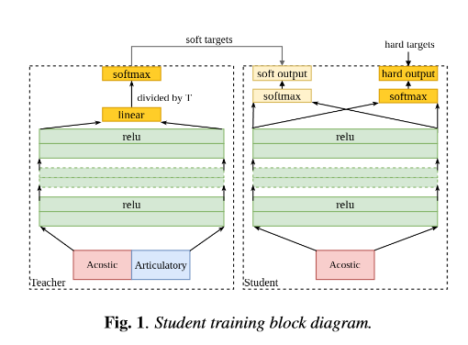
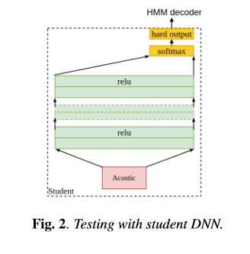
DATASET
In our project, we used the TORGO database available at TORGO dataset
This dataset consists of aligned acoustics and measured 3D articulatory features from speakers.
NEURAL NETWORK ARCHITECTURE

Slide 6
WORK COMPLETED TILL NOW
Targets for the DNN training are obtained by training a GMM-HMM system on both articulatory and acoustic features. This is done using the KALDI speech recognition toolkit.
Identification of the target states using forced alignment using the KALDI speech recognition toolkit
Concatenation of articulatory and acoustic features from the TORGO dataset.
The concatenated articulatory and the acoustic features have been fed as input to the Teacher DNN which is currently training on an Amazon EC2 instance.
One we get the soft labels out of the Teacher DNN, we will implement the custom Loss Function to train the Student DNN using the soft labels and the hard labels predicted by the GMM-HMM model and measure the performance(Word Error Rate)

